Slide 1
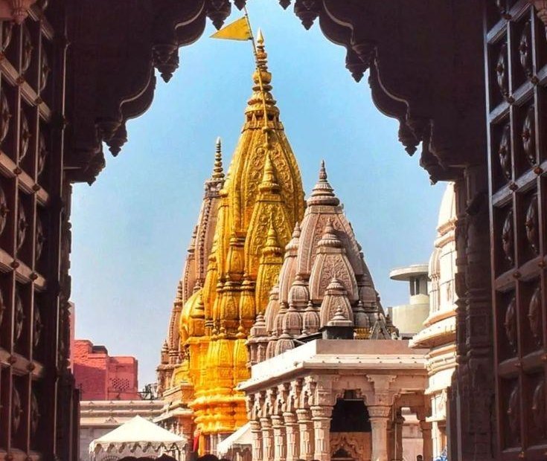
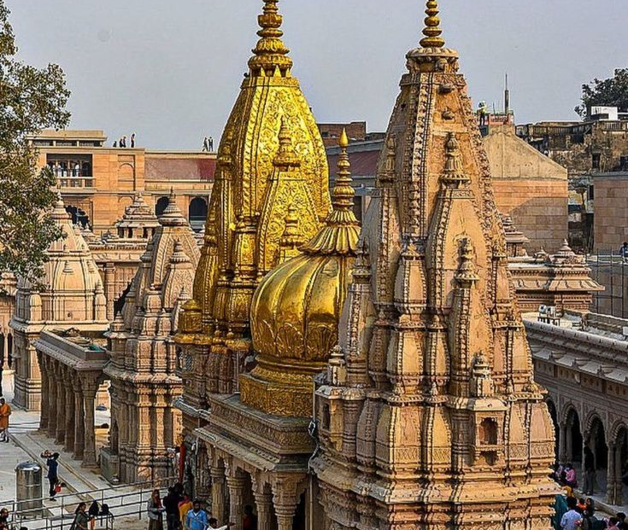
DIABETES MILLITES
ॐ नमो भवाय शर्वायरुद्राय वरदाय च।​​
पशुनां पतये नित्यंउग्राय च कपर्दिने॥1॥​​
BY AKHILESH KUMAR SRIVASTAVA​

Slide 2

DIABETES MELLITUS
•Definition: Diabetes mellitus is a clinical syndrome characterised by hyperglycaemia due to absolute or relative deficiency of insulin.
•The Disease is characterised by metabolic abnormalities and by long term complications involving eyes, kidneys, nerves and blood vessels.
•DM is the most common endocrine disease.

Slide 3
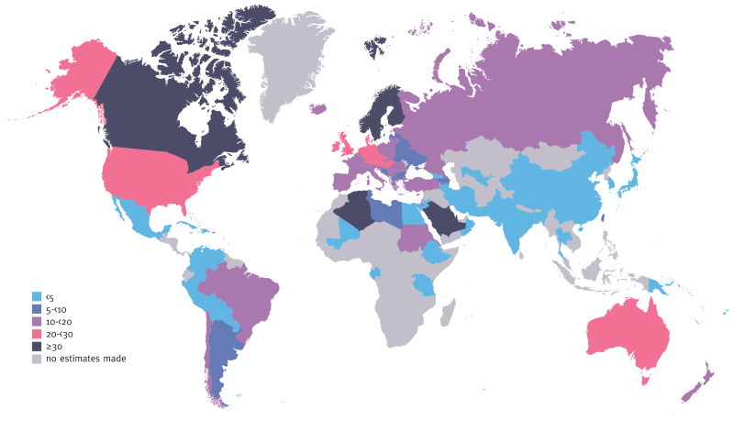
Epidemiology of diabetes
Our study estimates that in 2021, in India there are 101 million people with diabetes and 136 million people with prediabetes,
Every 5 seconds a person is dying from acute and chronic complication of diabetes.
Globally 500 million people are suffering from diabetes mellitus

Slide 4
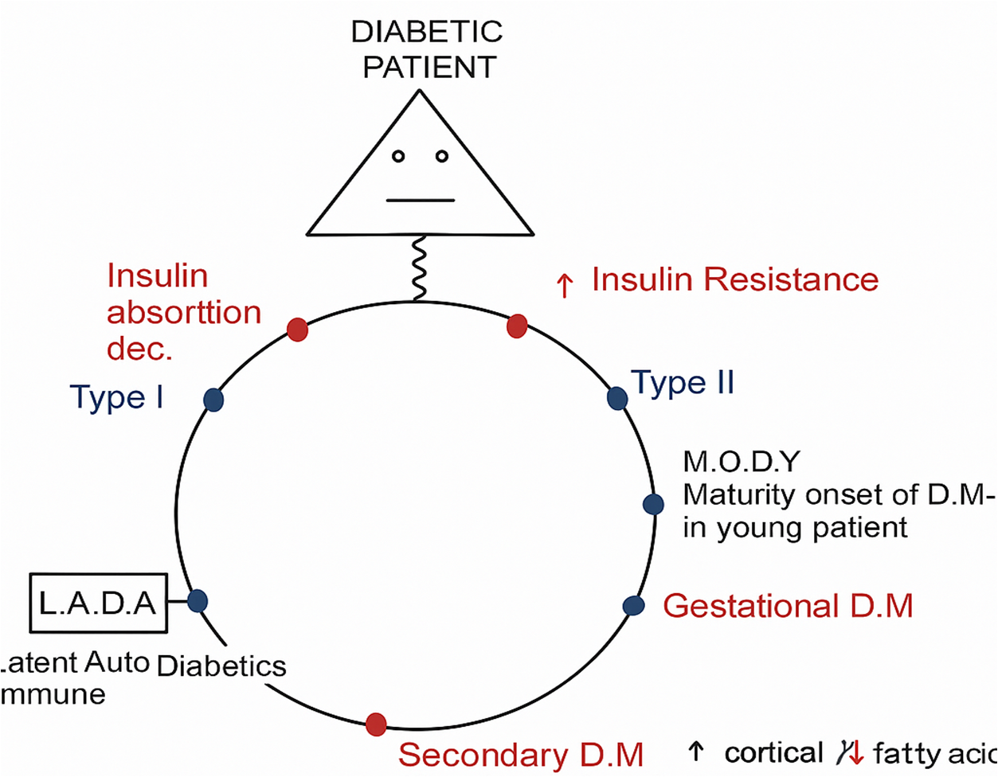
CLASSIFICATION OF DIABETES

Slide 5
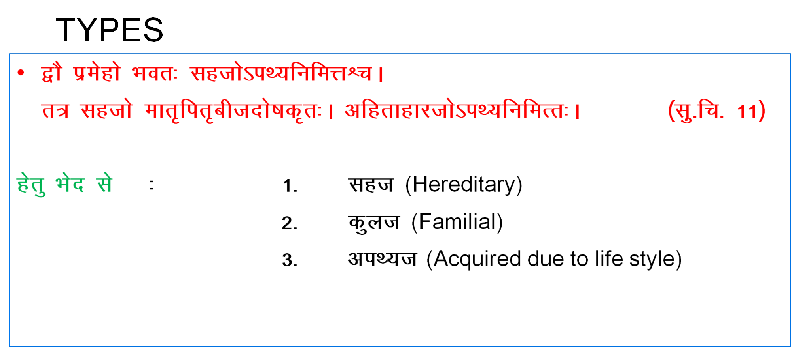

Slide 6

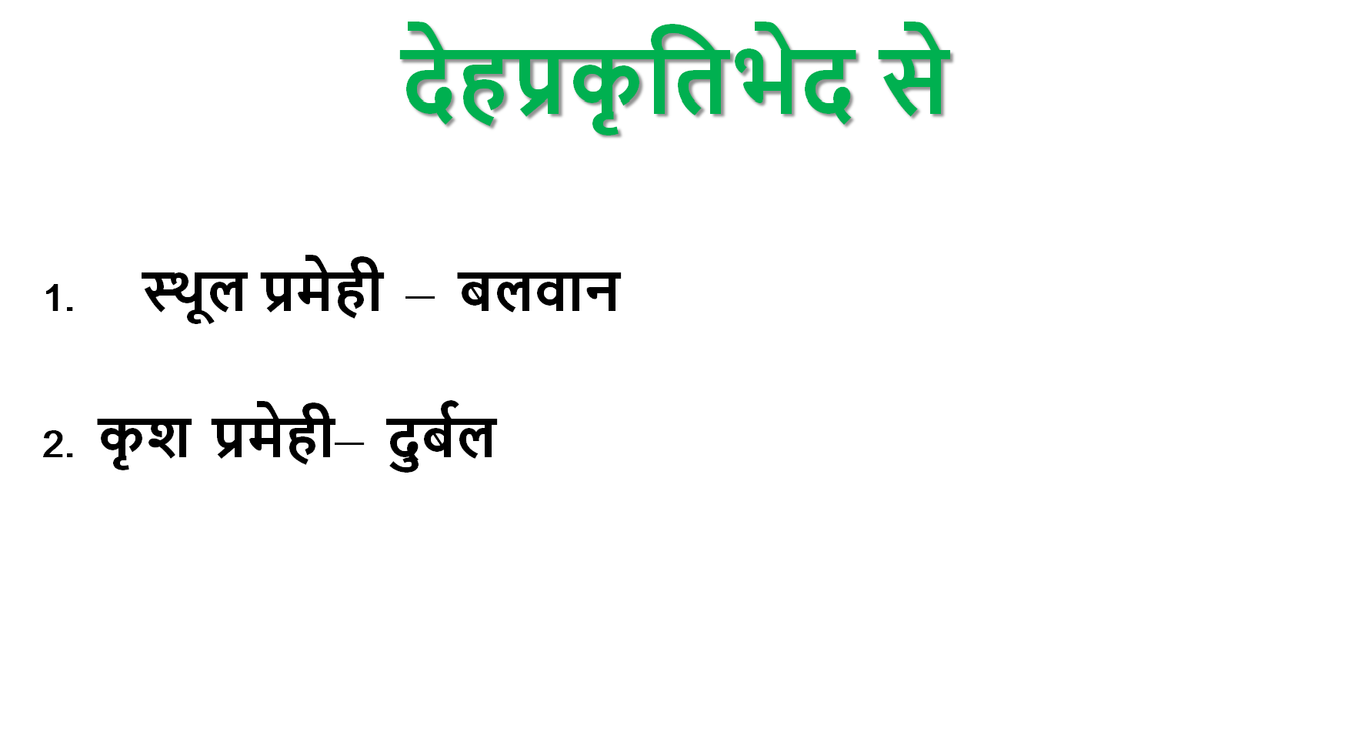

Slide 7

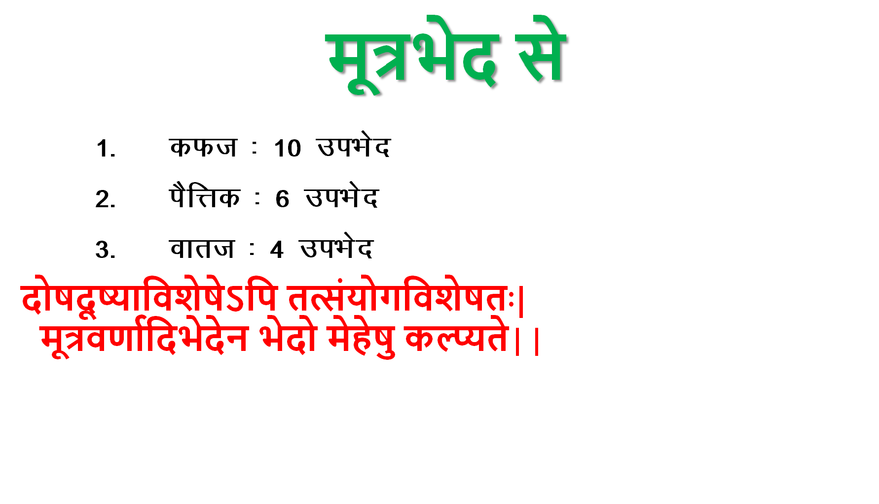

Slide 8
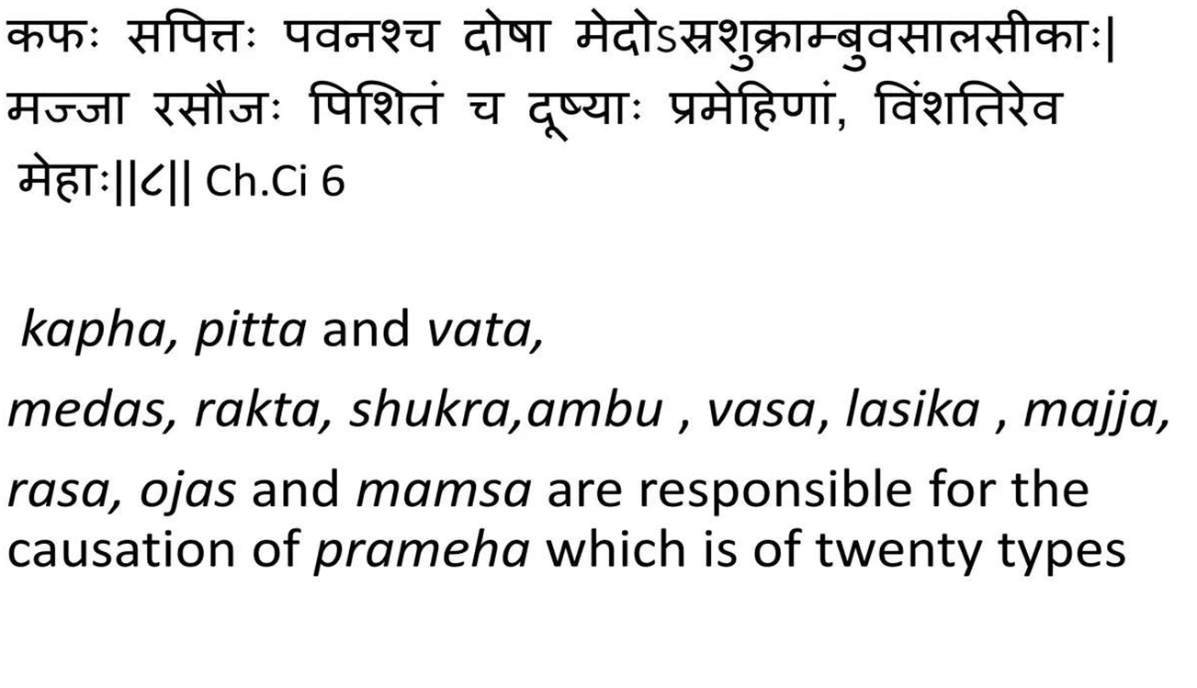
PRAMEHA DUSHYA

Slide 9
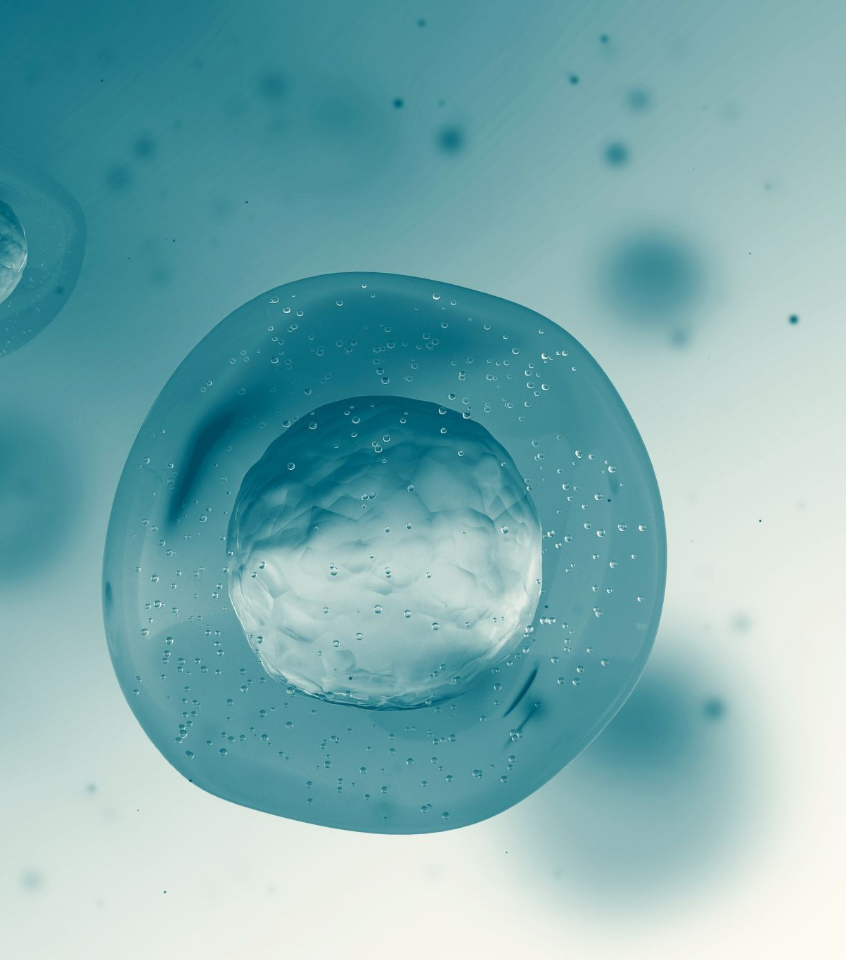
Daibetes type 1
ØIt is considered as Insulin dependent DM
Ø Juvenile onset DM
Ø Low defree of genetic predisposition
Ø More prone to keto acidosis .
Ø Complete lack of insulin secretion .
Cause –
Probably due to auto immune disorder .
Antibodies destroy b cells of Islands of Langerhans

Slide 10
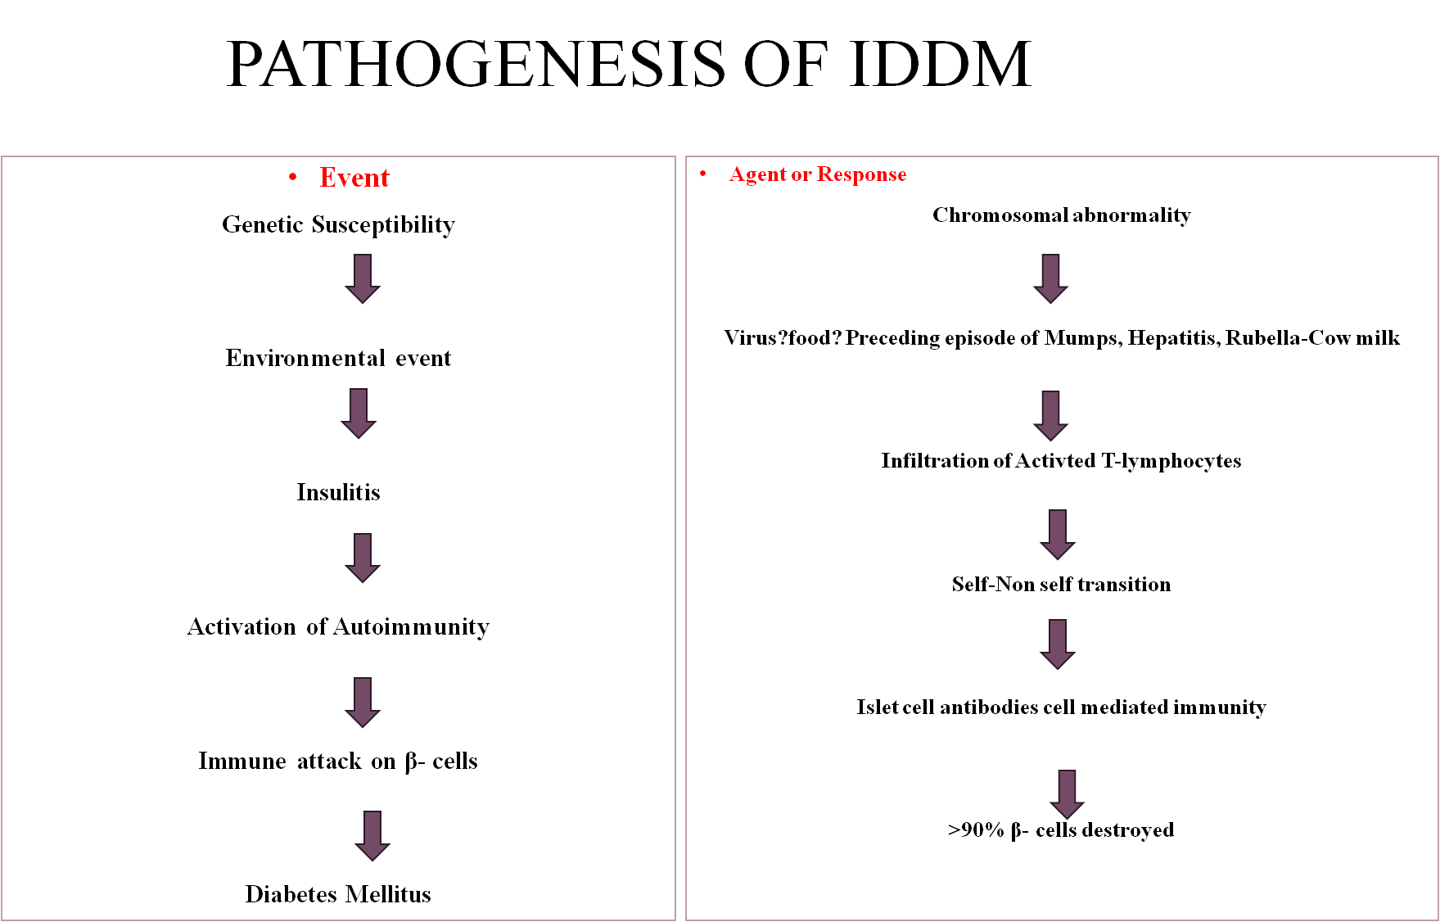

Slide 11
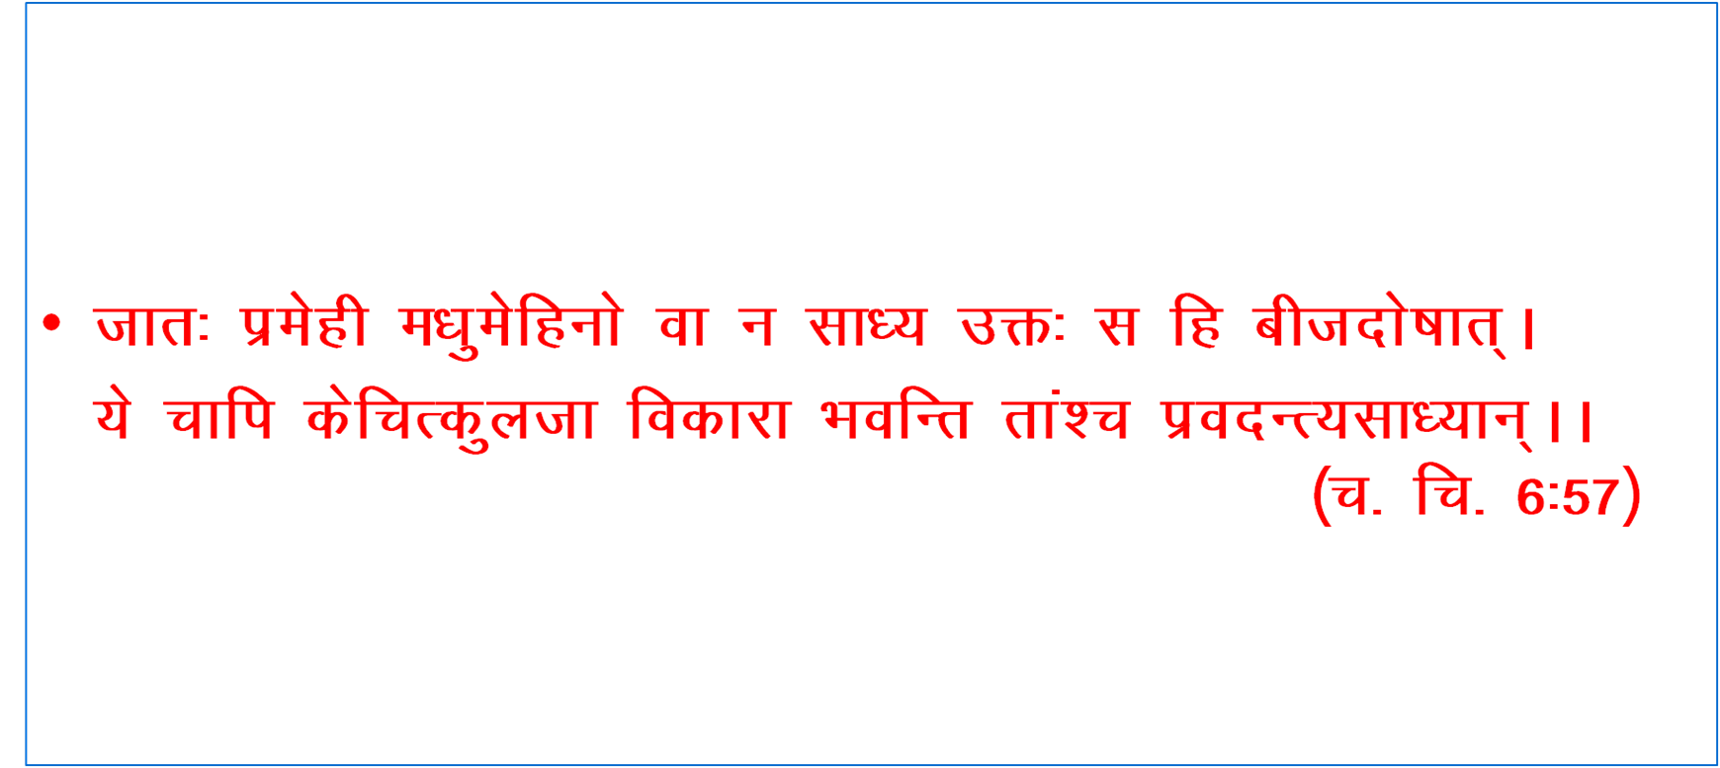

Slide 12
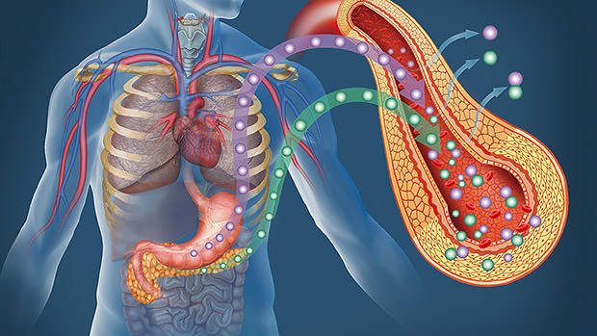
Type 2 dm niddm non ketotic diabetes

Slide 13
Diabetes type 2
•It is considered as Non-insulin dependent diabetes mellitus.
•Maturity onset DM.
•High degree of genetic predisposition.
•Less prone to keto-acidosis.
•Insulin secretion is normal.
•No anti β- cell antibody is demonstrable.

Slide 14
Causes-
-β- cell responded higher glucose concentration.
-Reduction in no of insulin receptors in peripheral tissue.
-Increased level of hyperglycemic hormones and obesity.

Slide 15
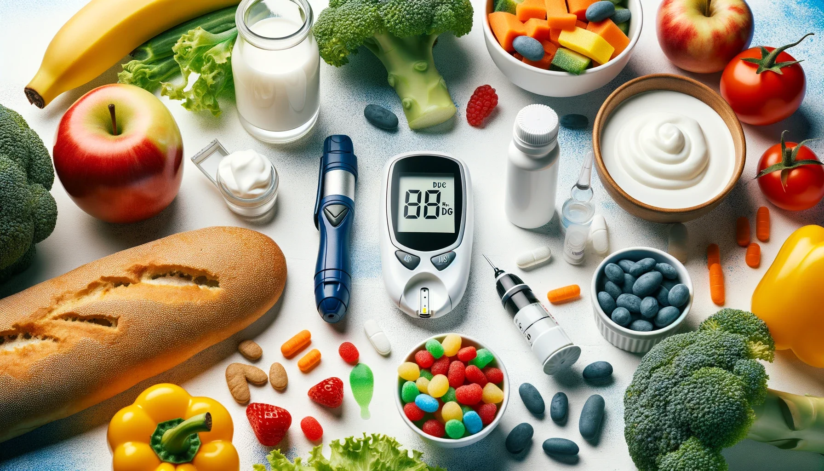
Aetiopathogenesis of NIDDM
Genetic Factors
-0 Monozygotic Twins
Obesity
Insuline Receptor Defect

Slide 16
Feature | Type 1 DM | Type 2 DM
Frequency | 10 – 20 % | 80 - 90 %
Age of onset | Early below 40 yrs | Late after 40 yrs
Type of onset | Abrupt and severe | Gradual and insidious
Weight | Normal | Obese
HLA | HLA Linked | No HLA association
Genetics | < 20 % | About 60 %
Identical twins | 50 % chance in identical twins | 95 % chance in identical twins
Pathogenesis | Auto immune | Insulin Resistance
Blood insulin level | Decreased insulin | Normal or increased insulin
Islet cell antibodies | Yes | No
Islet cell changes | Insulitis , beta cell depletion | No insulitis mild beta cell depletion
Clinical management | Insulin and diet | Diet and oral drugs

Slide 17
प्रमेहोऽनुषङ्गिणां

Slide 18
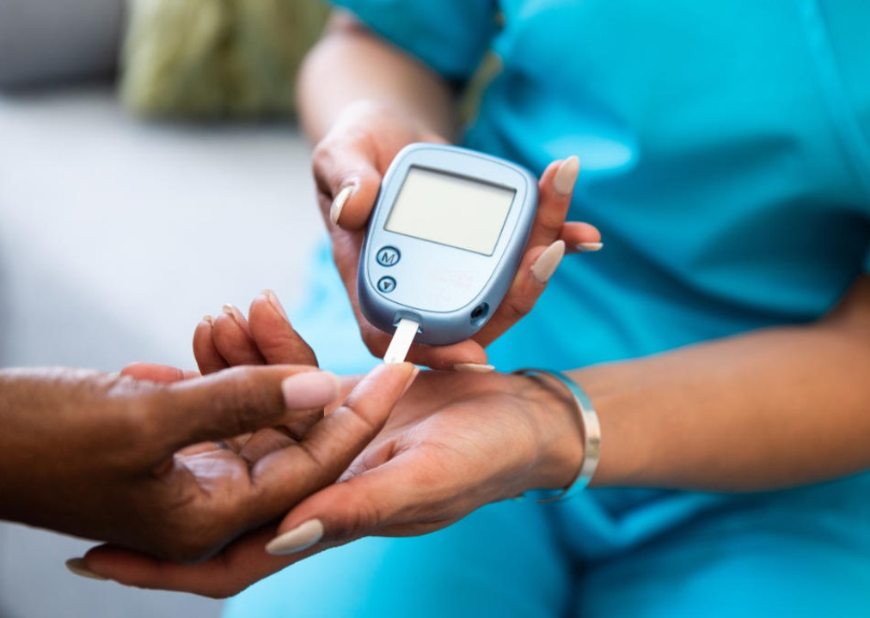
SECONDARY Dm
1.Due to pancreatic-
Pathology- Pancreatitis
- Pancreatectomy
- Cystic fibrosis
2. Hormonal abnormality- Growth hormone
- Corticosteroids
- Thyroid
- Glucagon
- Corticosteroids
3. Due to drugs- Corticosteroids
- Thiazide diuretics
- Phenetoin

Slide 19
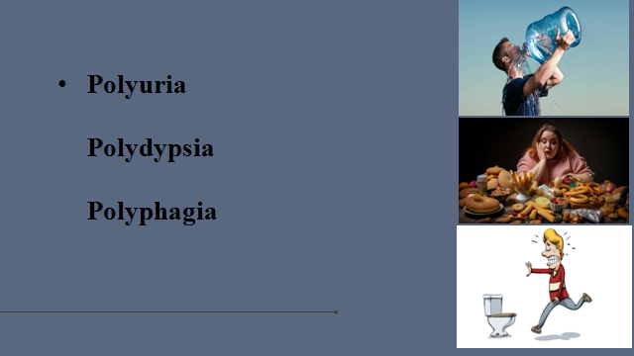

Slide 20

Prameha nirukti
1.प्रमेह- प्रमेह शब्द ‘प्र’ उपसर्गपूर्वक ‘मिहक्षरणे’ धातु से ‘घञ्’ प्रत्यय करने पर बना है I
जिसका अर्थ है प्रभूत मात्रा में विकृतमूत्र का त्याग करना।
2. मधुमेह- ‘मधु + मेह' 'मेहेषु उच्च मधु इव मधुरं मेहति’।
अर्थात् मेहों (प्रमेहों) में जो उच्च है, मधु के समान मधुर मूत्र त्याग करता है वह मधुमेह है।

Slide 21
Paribasha
•प्रकर्षेण प्रभूतं प्रचूरं वारंवारं वा मेहति मूत्रत्यागं करोति यस्मिन् रोगे स प्रमेहः। (Ma.Ni 33/1)
• बार-बार और प्रायः गंदले मूत्र का त्याग प्रमेह कहलाता है।
•बहुद्रवः श्लेष्मा दोषविशेषः ॥ (ch.ni 4/6 )॥
•प्रमेह में अत्यन्त द्रव कफ दोष विशेष है ।॥ ६ ॥
•

Slide 22

APPLICATION OF NIDAN
•आस्यासुखं स्वप्नसुखं दधीनि ग्राम्यौदकानूपरसाः पयांसि| नवान्नपानं गुडवैकृतं च प्रमेहहेतुः कफकृच्च सर्वम्
You are more likely to develop type 2 diabetes if you are not physically active and are overweight or have obesity. Extra weight sometimes causes insulin resistance and is common in people with type 2 diabetes. The location of body fat also makes a difference.

Slide 23
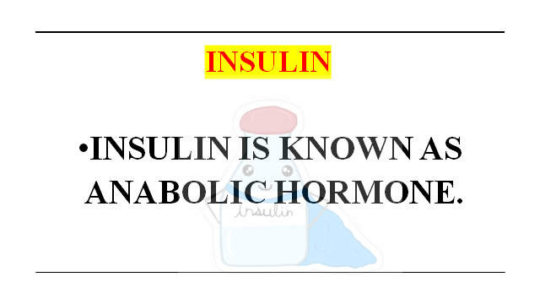

Slide 24
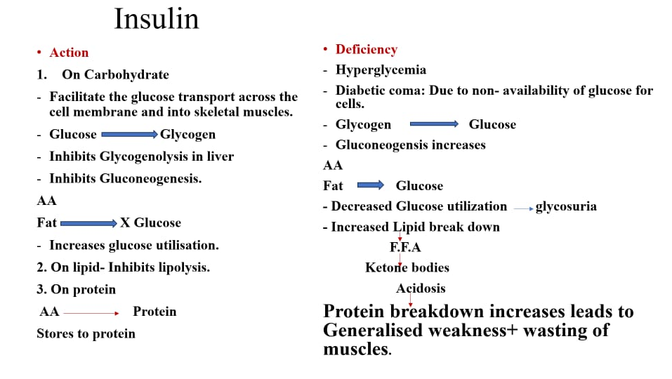

Slide 25
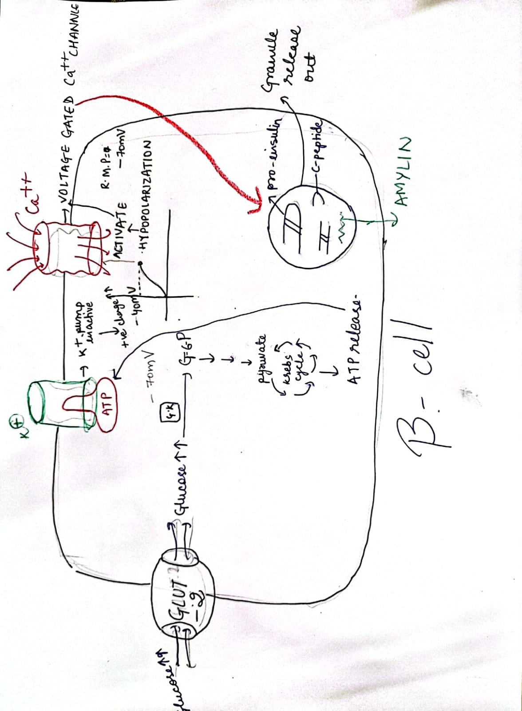
MECHANISM OF ACTION OF INSULIN

Slide 26
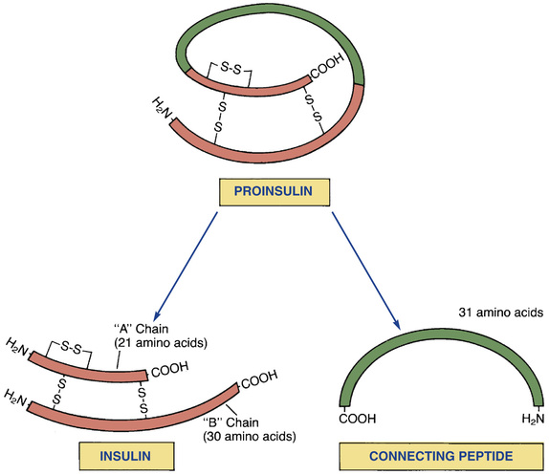

Slide 27
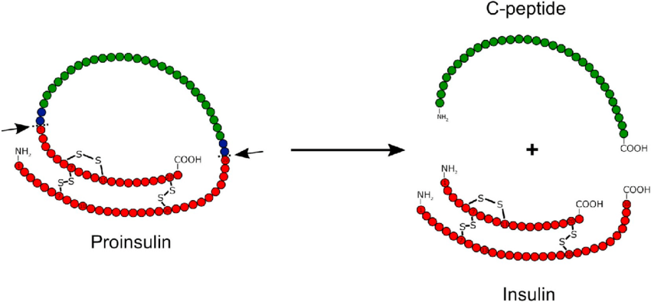

Slide 28
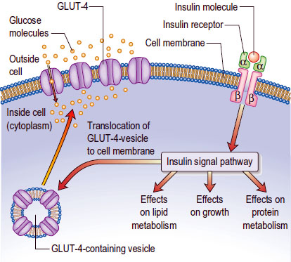

Slide 29
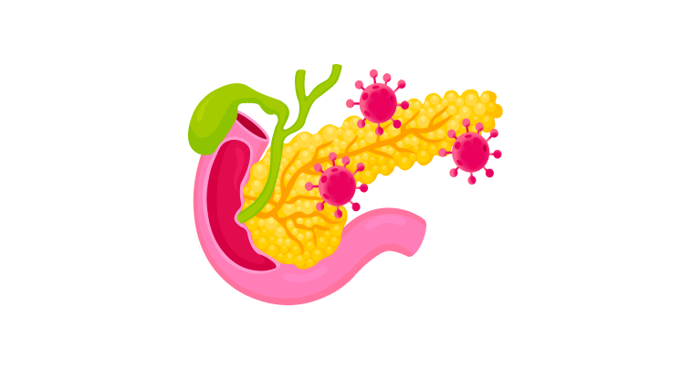
FUNTIONS OF INSULIN
✅ Enhances glycogen synthesis in liver and muscle
✅ Inhibits glycogenolysis (breakdown of glycogen)
✅ Inhibits gluconeogenesis from proteins & fats
✅ Inhibits lipolysis, promotes fat storage
✅ Increases protein synthesis, reduces protein breakdown
✅ Enhances lipoprotein lipase activity → ↑ clearance of VLDL, chylomicrons
✅ Supports amino acid uptake and anabolic processes
✅ Exerts rapid, intermediate, and long-term metabolic effects

Slide 30
Purvarupa charka
स्वेदोऽङ्गगन्धः शिथिलाङ्गता च शय्यासनस्वप्नसुखे रतिश्च। हृन्नेत्रजिह्वाश्रवणोपदेहो घनाङ्गता केशनखातिवृद्धिः ॥ शीतप्रियत्वं गलतालुशोषो माधुर्यमास्ये करपाददाहः ।भविष्यतो मेहगदस्य रूपं मूत्रेऽभिधावन्ति पिपीलिकाश्च ॥(च.चि. ६/१३-१४)

Slide 31
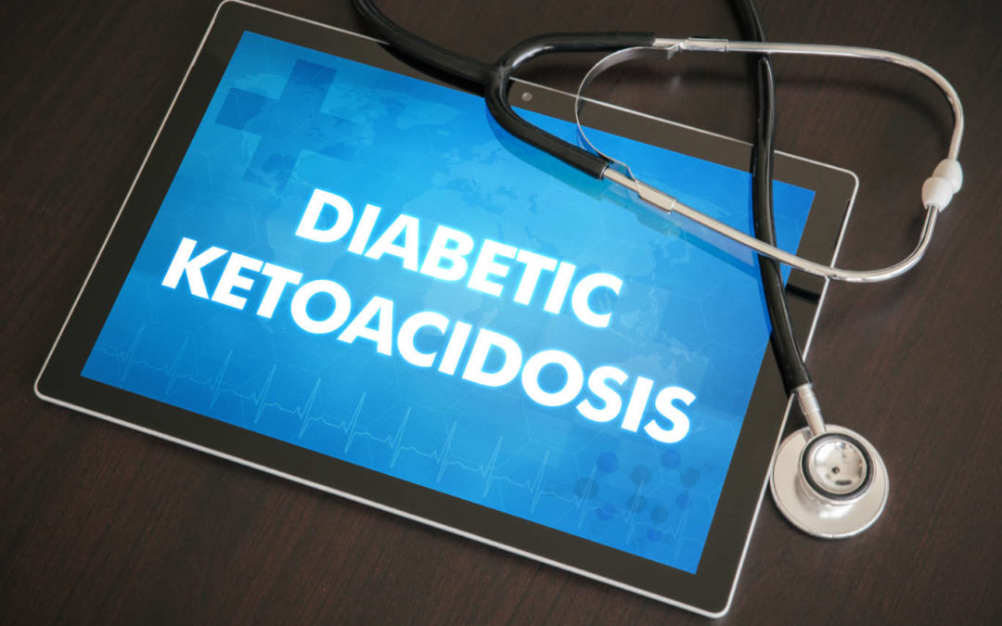
Acute complication
Type 1 diabetes- DIABETIC KETOACIDOSIS

Slide 32
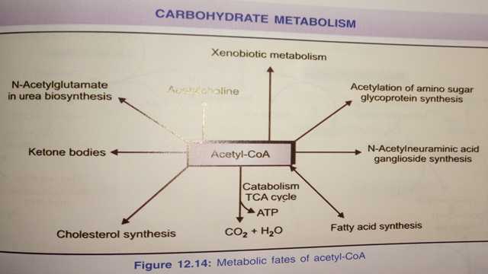

Slide 33
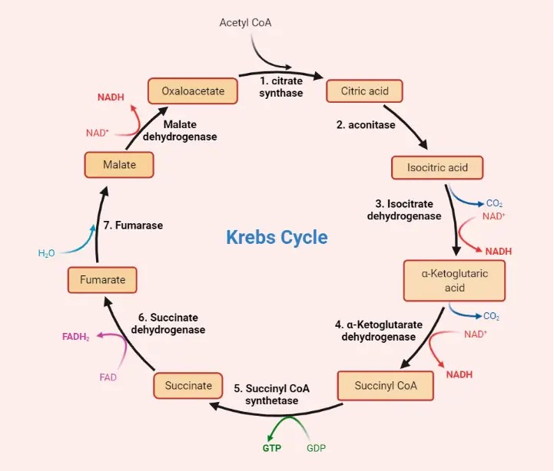
Tca CYCLE

Slide 34
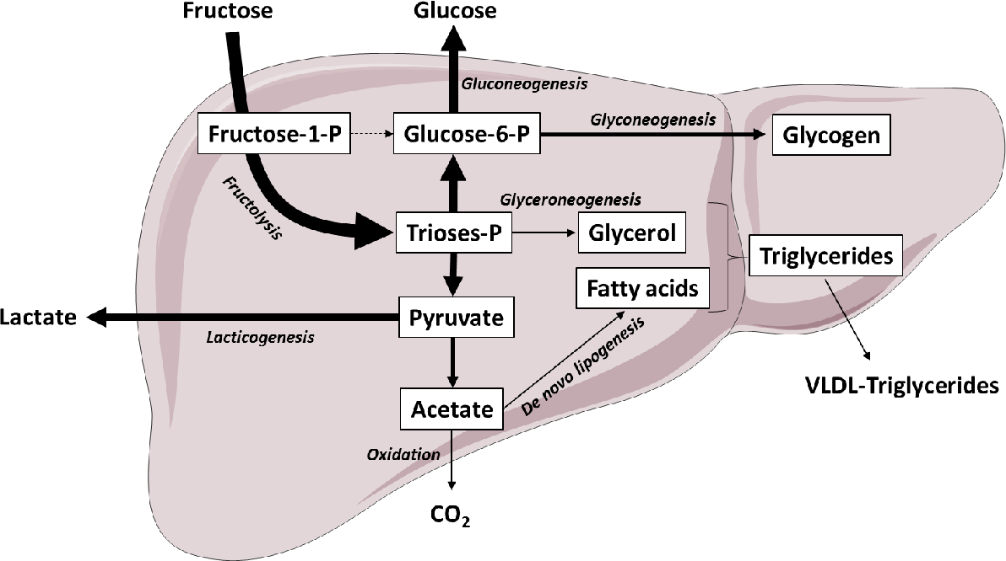
FRUCTOSE CYCLE

Slide 35
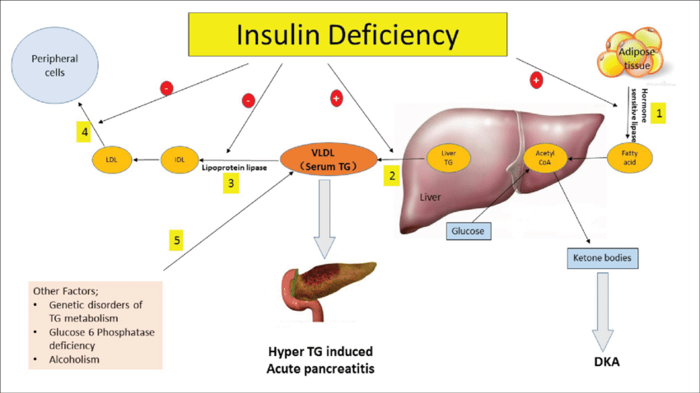
Lipoprotein lipase and insulin

Slide 36
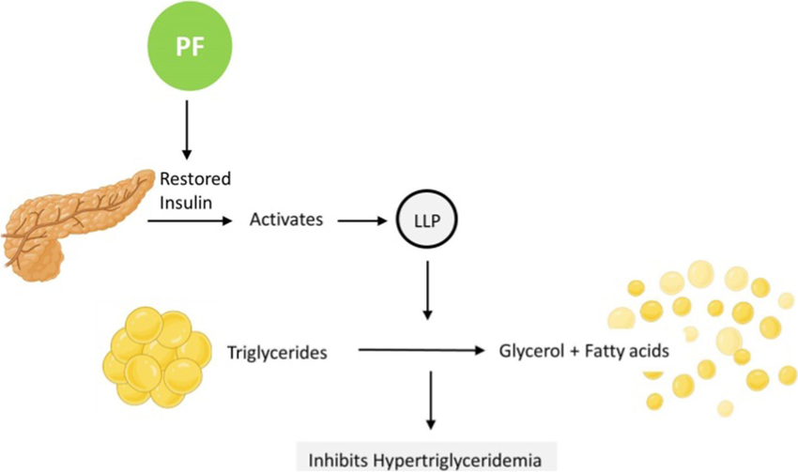
Lipoprotein lipase

Slide 37
आमजन्य विकार
तत्र श्लेष्मलाहारसेविनोऽध्यशनशीलस्याव्यायामिनो दिवास्वप्नरतस्य चाम एवान्नरसो मधुरतरश्च शरीरमनुक्रामन्नतिस्नेहान्मेदो जनयति, तदतिस्थौल्यमापादयति [ ; तमतिस्थूलं क्षुद्रश्वासपिपासाक्षुत्स्वप्नस्वेदगात्रदौर्गन्ध्यक्रथनगात्रसादगद्गदत्वानि क्षिप्रमेवाविशन्ति, सौकुमार्यान्मेदसः सर्वक्रियास्वसमर्थः, कफमेदोनिरुद्धमार्गत्वाच्चाल्पव्यवायो भवति, आवृतमार्गत्वादेव शेषा धातवो नाप्यायन्तेऽत्यर्थमतोऽल्पप्राणो भवति, प्रमेहपिडकाज्वरभगन्दरविद्रधिवातविकाराणामन्यतमं प्राप्य पञ्चत्वमुपयाति, सर्व एव चास्य रोगा बलवन्तो ^{[३]} भवन्त्यावृतमार्गत्वात् स्रोतसाम्; अतस्तस्योत्पत्तिहेतुं परिहरेत् |

Slide 38
संतर्पण जन्य व्याधि
सन्तर्पयति यः स्निग्धैर्मधुरैर्गुरुपिच्छिलैः| नवान्नैर्नवमद्यैश्च मांसैश्चानूपवारिजैः||३|| गोरसैर्गौडिकैश्चान्नैः ^{[१]} पैष्टिकैश्चातिमात्रशः| चेष्टाद्वेषी दिवास्वप्नशय्यासनसुखे रतः||४|| रोगास्तस्योपजायन्ते सन्तर्पणनिमित्तजाः| प्रमेहपिडकाकोठकण्डूपाण्ड्वामयज्वराः||५||

Slide 39
बहुद्रवः श्लेष्मा दोषविशेषः

Slide 40
Prameha samprapti
मेदश्च मांसं च शरीरजं च क्लेदं कफो बस्तिगतं प्रदूष्य|
करोति मेहान् समुदीर्णमुष्णैस्तानेव पित्तं परिदूष्य चापि||५||
क्षीणेषु दोषेष्ववकृष्य बस्तौ धातून् प्रमेहाननिलः करोति|
दोषो हि बस्तिं समुपेत्य मूत्रं सन्दूष्य मेहाञ्जनयेद्यथास्वम्||६||

Slide 41
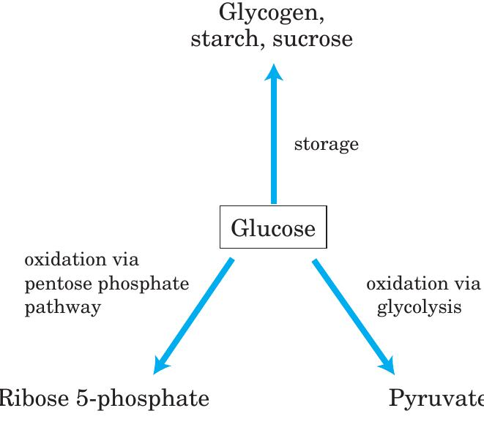
Heavy, high-calorie food + sedentary lifestyle)
Jatharagni Mandya
(Weakened digestive/metabolic fire).
Excess Glucose in Bloodstream
Glucose is directed into 3 main pathways:
🔁 If Glucose Still in Excess:
Lipogenesis (Triglyceride Formation)
Excess glucose converted into fat
( बहुद्रवः श्लेष्मा दोषविशेषः )

Slide 42
Bahudrava Meda & Mamsa ( बहुद्रवः श्लेष्मा दोषविशेषः )
(unwanted TGs formation)
Kleda & Mala Vriddhi (AMA)
(Accumulation of metabolic waste, excessive excretions)
Vasti (Basti) Dushti
(Urinary system is overburdened)
Kaphja Prameha
(Chronic urinary disease with features of diabetes, cloudy urine, frequent urination, etc.)
Vata carries kleda and mala

Slide 43
समुदीर्णमुष्णैस्तानेव पित्तं परिदूष्य चापि|
Samudhenam Ushnasthane Pittam Pari-dushyati
(Pitta aggravation leads to Obesity-Driven Metainflammation)
Chronic Meta-inflammation (Sthayi Aagantuja Agni-dushti)
(↑ IL-6, TNF-α, CRP, adipokines → low-grade systemic inflammation)
Dhatu Daurbalya + Agni Dushti in all Dhatus
(Mamsa, Rasa, Rakta, Majja, etc. degeneration)
Increased catabolic activity and lipolysis in adipose tissue
(↑ free fatty acids, reactive oxygen species, metabolic acidosis)
Pittaja Vitiation (↑ Ushna, Tikshna, Amla, Drava gunas)
Pittaja prameha

Slide 44
Excess Kapha → Kapha-dominant Prameha
↓Meda Dhatu Agni becomes Mandya (weak)
No proper transformation beyond Meda
→ Asthi, Majja, Shukra Dhatus are not formed
Undigested, untransformed portion accumulates
→ Becomes Ama (toxic metabolic waste)
Vata becomes aggravated due to dhatu kshaya & blocked transformation
Vata mobilizes all this immature/undigested material (Ama, Mala)
Vata carries it toward Basti (urinary tract) for elimination
Ama + Mala excreted through Mutra
→ Leads to various forms of *Prameha*

Slide 45
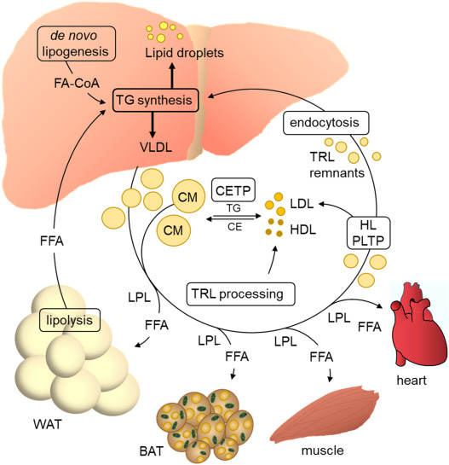

Slide 46
PRAMEHA DUSHYA
बह्वबद्धं ^{[१]} मेदो मांसं शरीरजक्लेदः शुक्रं शोणितं वसा मज्जा लसीका रसश्चौजःसङ्ख्यात इति दूष्यविशेषाः||
Charak Nidana 4-7

Slide 47
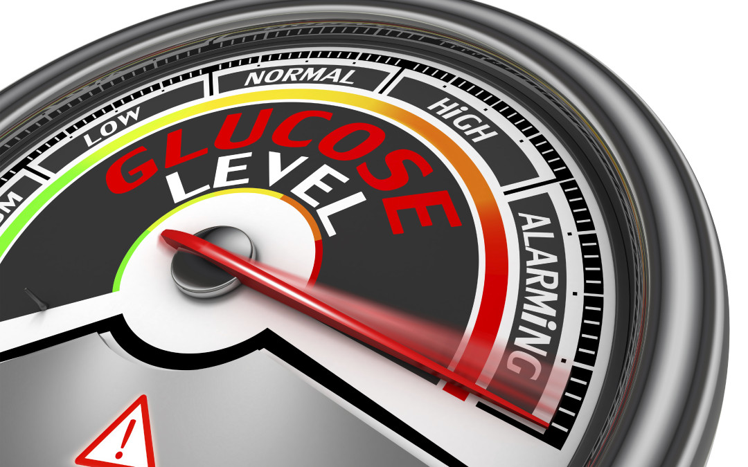
HHS ( HYPEROSMOLAR HYPERGLYCEMIC SYNDROME)

Slide 48
Sadhyasadhyata
साध्याः कफोत्था दश, पित्तजाः षड् याप्या, न साध्यः पवनाश्चतुष्कः । समकियत्वाद्विषमक्रियत्वान्महात्ययत्वाच्च यथाक्रमं ते ॥ ७ ॥

Slide 49
PRAMEHA CHIKITSA SUTRA
स्थूलः प्रमेही बलवानिहैकः कृशस्तथैकः परिदुर्बलश्च| सम्बृंहणं तत्र कृशस्य कार्यं संशोधनं दोषबलाधिकस्य||१५||

Slide 50
DIAGNOSIS OF DM
CRITERIA 1:Symptoms with Hyperglycemia.
CRITERIA 2: Asymptomatic cases with Fasting glucose ≥ 250 mg/dl.
CRITERIA 3:Asymptomatic cases with normal fasting blood Glucose Prone to diabetes.

Slide 51
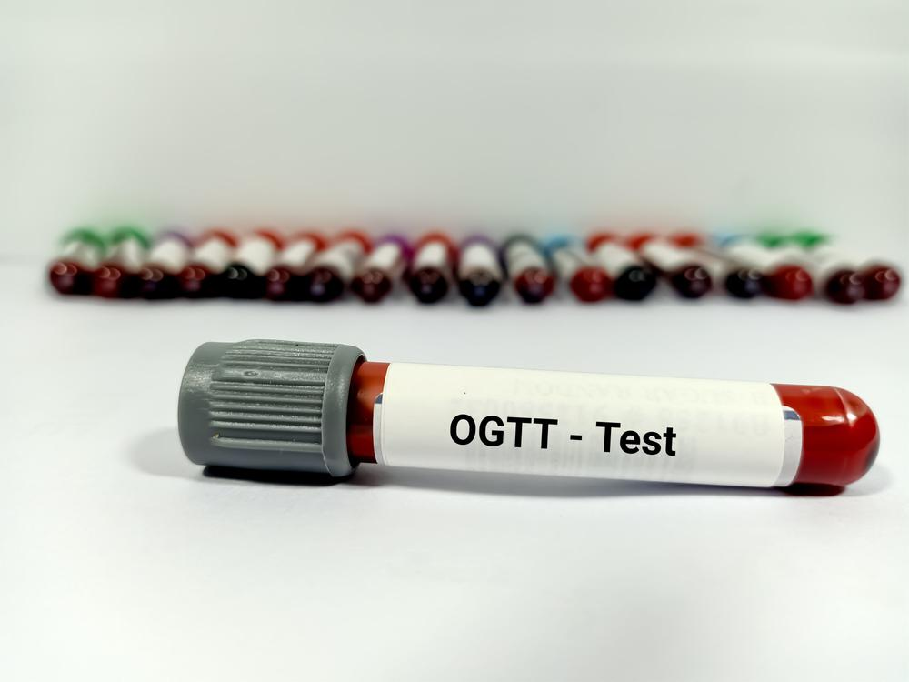
Asymptomatic cases with normal fasting blood Glucose Prone to diabetes.
By blood Test-
OGTT- Criteria of National Institute of Health
Fasting blood glucose ≥ 120mg/dl more than two occasions
PP values ≥ 180mg/dl on two occasions.
If PP value is between 120-180 on one occasion and above 180 on another occasion it is called chemical diabetes, they are prone to become diabetic in future.

Slide 52
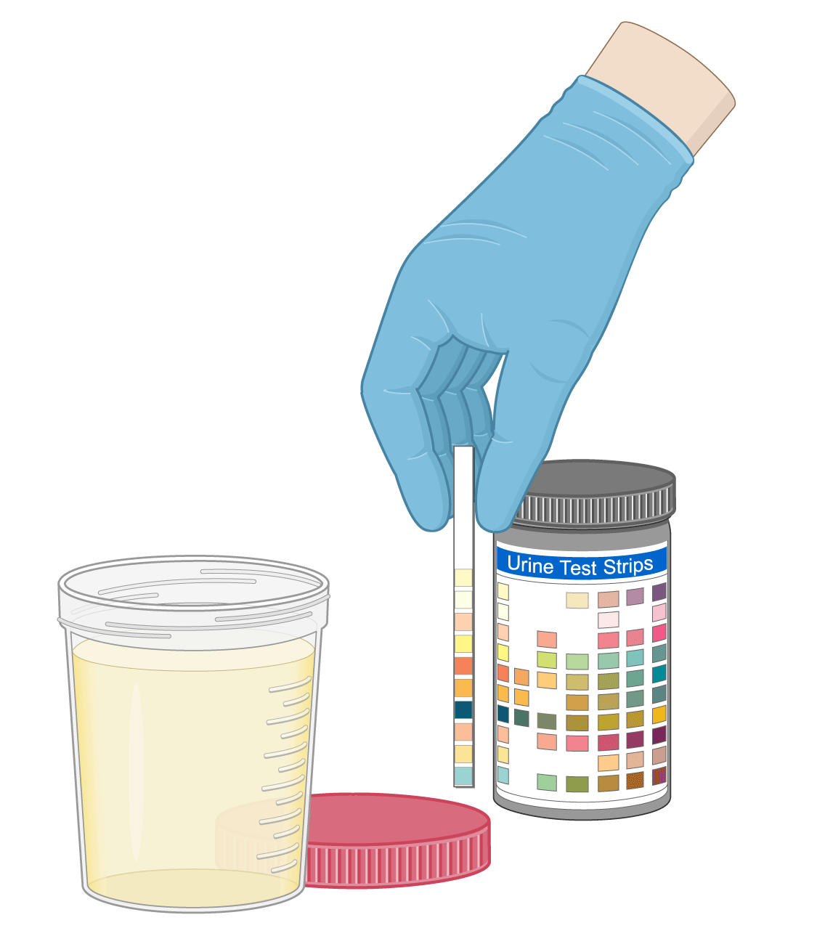
BY URINE TEST
Urine for ketone bodies
Urine for Sugar-

Slide 53

INVESTIGATIONS

Slide 54
Test Name | Significance | Normal Range
Fasting Plasma Glucose (FPG) | Detects baseline glucose level after overnight fasting | 70–99 mg/dL
Oral Glucose Tolerance Test (OGTT) | Measures glucose handling post glucose load | <140 mg/dL (2-hr value)
Random Plasma Glucose (RPG) | Useful in symptomatic individuals | <200 mg/dL
HbA1c | Reflects long-term glycemic control over 2–3 months | <5.7%
C-Peptide | Reflects endogenous insulin production | 0.5–2.0 ng/mL (fasting)
Urine Glucose | Reflects renal threshold for glucose reabsorption | Negative
Urine Ketones | Detects ketogenesis in insulin deficiency | Negative
Urine Microalbumin (ACR) | Detects early diabetic nephropathy | <30 mg/g creatinine
Serum Creatinine & eGFR | Assess renal function | Cr: 0.6–1.2 mg/dL; eGFR >90

Slide 55
Test Name | Significance | Normal Range
Lipid Profile | Assesses cardiovascular risk associated with diabetes | LDL <100 mg/dL, HDL >40 mg/dL (M), TG <150 mg/dL
Liver Function Tests (ALT, AST) | Detect associated NAFLD/NASH in T2DM | ALT/AST <40 IU/L
Fundus Examination | Detects diabetic retinopathy | Normal retina

Slide 56
INCRETINS
Incretins are gut-derived peptide hormones that are released after eating (postprandially) and stimulate insulin secretion from the pancreas in a glucose-dependent manner. They are part of the "entero-insular axis"—the communication between the gastrointestinal tract and pancreatic islets
Incretin Hormone | Source | Main Function
GLP-1 (Glucagon-like peptide-1) | L-cells (ileum & colon) | ↑ Insulin secretion ↓ Glucagon Slows gastric emptying Promotes satiety
GIP (Glucose-dependent insulinotropic polypeptide) | K-cells (duodenum & jejunum) | ↑ Insulin secretion Minimal effect on glucagon or gastric emptying

Slide 57
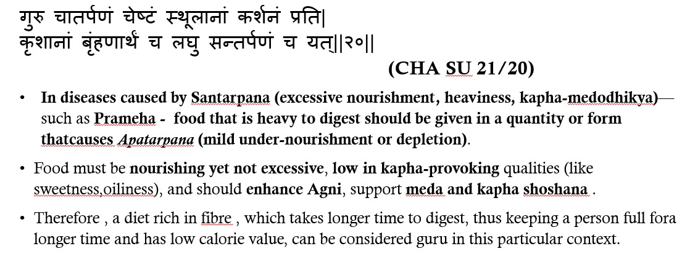

Slide 58
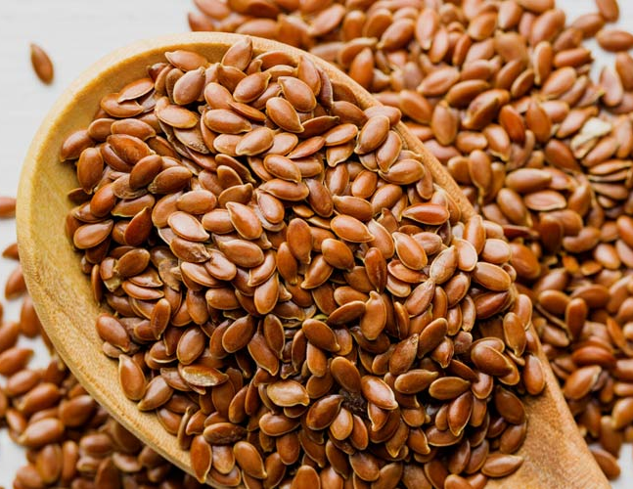
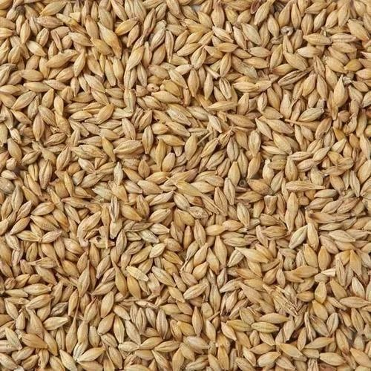
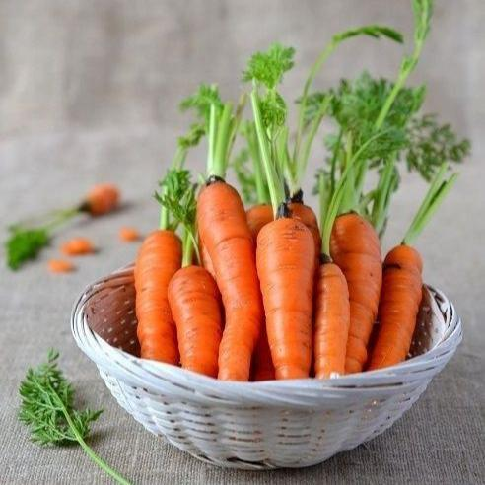
Ghuru aptarpan
•Flaxseed
•Chia seeds
•Carrots
•Barley
•Brocolli

Slide 59

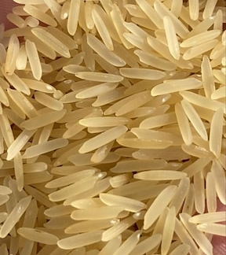
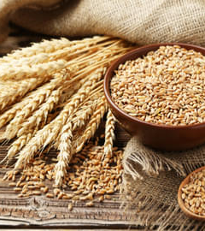
LAGHU SANTARPAN
SHALI RICE
LAJA
GODHUMA
MASOOR DAL
TAKRA

Slide 60
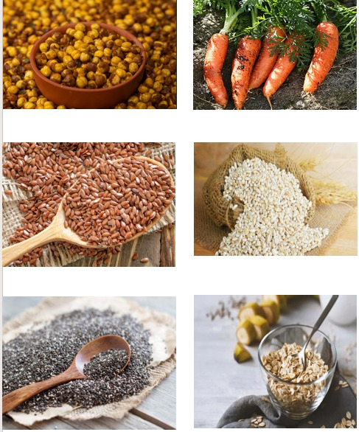
Nutritional Strategy | Effect on Incretins / Metabolism
High-fiber diet (e.g. whole grains, legumes, vegetables) | Slows gastric emptying → ↑ GLP-1 release Improves satiety, lowers postprandial glucose
Moderate healthy fats (e.g. olive oil, nuts, omega-3) | Stimulates GLP-1 secretion via gut receptors
Low Glycemic Index (GI) foods | Avoids glucose spikes, supports gradual insulin and incretin release
Protein-rich meals | Certain amino acids (arginine, leucine) promote GLP-1 and insulin secretion
Avoid high-sugar processed foods | These cause rapid glucose spikes → minimal incretin response and early exhaustion of β-cells
Frequent small meals | Help maintain steady glucose and incretin stimulation
Following slide shows example of an ayurvedic diet plan based on above said principle

Slide 61
COMPLICATIONS
CHRONIC COMPLICATONS IN VASCULATURE

Slide 62
Type | Complication | Description | Pathology Involved
Microvascular | Diabetic Retinopathy | Progressive damage to retinal microvasculature leading to vision impairment | - Pericyte loss, basement membrane thickening of retinal capillaries - Capillary microaneurysms, retinal ischemia, and VEGF-mediated neovascularization - Advanced: proliferative retinopathy with fibrous proliferation, hemorrhage, retinal detachment
 | Diabetic Nephropathy | Glomerular injury progressing to end-stage renal disease | - Diffuse mesangial expansion, glomerular basement membrane (GBM) thickening - Kimmelstiel-Wilson nodules (nodular glomerulosclerosis) - Arteriolar hyalinosis of afferent and efferent arterioles - Tubulointerstitial fibrosis
 | Diabetic Neuropathy | Sensory, motor, and autonomic nervous dysfunction | - Axonal degeneration and segmental demyelination - Endoneurial microvascular disease - Accumulation of sorbitol and fructose due to aldose reductase activity → osmotic and oxidative stress
 | Diabetic Foot Ulcers | Non-healing ulcers prone to infection and gangrene | - Peripheral sensory neuropathy, motor neuropathy (→ deformities) - Autonomic neuropathy (↓ sweating → dry skin → fissures) - Compounded by microangiopathy, macroangiopathy, and impaired leukocyte function
Macrovascular | Coronary Artery Disease | Atherosclerosis of coronary vessels → angina, myocardial infarction | - Accelerated atherosclerosis due to endothelial dysfunction, hyperglycemia-induced ROS, AGEs (advanced glycation end-products) - Increased LDL oxidation, chronic inflammation, macrophage foam cell formation, plaque instability
 | Cerebrovascular Disease | Stroke or TIA due to large and small vessel involvement | - Same as above in cerebral vessels - Large-vessel atherosclerosis (carotids), lipohyalinosis, lacunar infarcts - Enhanced thrombogenicity and impaired fibrinolysis
 | Peripheral Artery Disease | Ischemia of limbs leading to claudication and ulcers | - Atherosclerotic occlusion of peripheral arteries - Ischemic myopathy of lower limbs - Endothelial dysfunction, decreased nitric oxide availability, inflammation

Slide 63
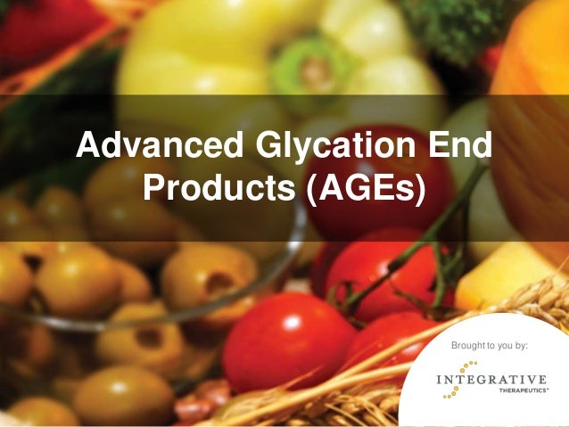
CAUSES OF CHRONIC COMPLICATIONS
Non enzymatic glycation
Increased level intracellular level of sorbitrol

Slide 64
Management
Diet
Exercise
Persons aged below 40 years-
insulin + weight maintaining diet.
Above 40 years-
a. Obese- Low energy diet ± Biguanides
b. Non-Obese-
Wt. maintenance diet ± Sulphonylurea ± + Biguanide ±Insulin.

Slide 65
DIET
Daily energy requirement
For an obese middle aged or elderly person 1000-1600 kcal/day.
An elderly person not over weight 1400-1800 kcal/daily.
To a young active person 1800-3000 kcal/day.

Slide 66
Permissible daily calorie intake per kg of desirable body weight(kcal)/ chart based on body wt./ activity
Total calory should be full-filled by-
55 to 60% of Calories – From Carbohydrates
12 to 15% of calories – From Protein
30% of calories – From Fat
 | Activity
Body mass | Sedentary | Moderate | Heavy
Standard weight | 30 | 35 | 40
Underweight | 35 | 40 | 45
Over weight | 20 | 25 | 30

Slide 67
Exercise
Well controlled exercise have insulin sparing effect i.e. Glucose will enter into the cell without the help of insulin.
Exercise will maintain the desirable weight of the person by which prevents, secondary complications like atherosclerosis.

Slide 68
What is Glycemic Index (GI)?
Benefit of Low GI Foods | Explanation
✅ Better blood sugar control | Slow digestion and absorption = gradual rise in blood glucose
✅ Prevents spikes & crashes | Avoids sharp peaks in sugar → reduces fatigue, irritability, cravings
✅ Improves insulin sensitivity | Sustained lower sugar levels = reduced insulin demand
✅ Supports weight management | Low GI foods keep us full longer, reducing overeating
✅ Reduces risk of complications | Stable sugars help prevent retinopathy, neuropathy, nephropathy, etc complications.
The Glycemic Index is a measure that ranks carbohydrate-containing foods based on how quickly they raise blood glucose levels after eating.
Scale: 0 to 100
GI ≠ Healthiness always. A food may have a low GI but still be unhealthy if high in fat (e.g., ice cream).
So always consider portion size, fiber, and nutrient content.

Slide 69
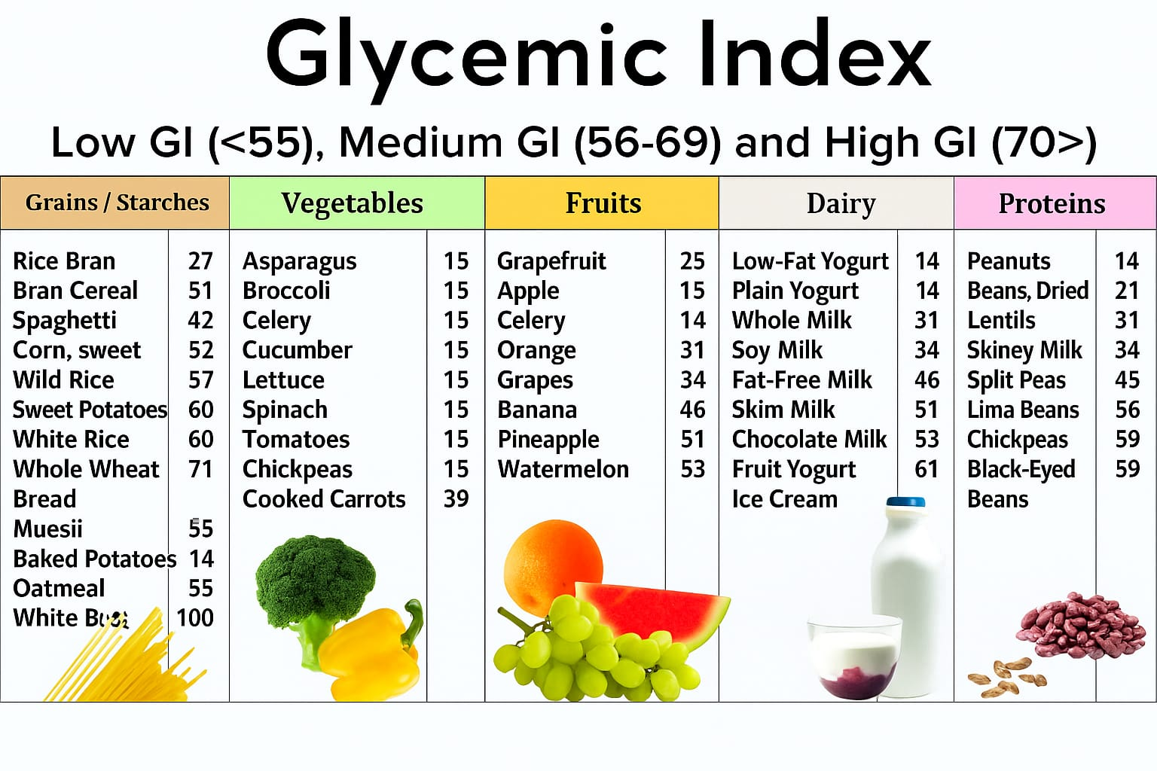

Slide 70
Indications of Oral Hypoglycaemic agents
In uncomplicated N.I.D.D.M (Type 2).
When not controlled by diet and exercise.
Age above 40 years at onset of disease.
Obesity at the time of presentation.
Duration of disease<5 years when starting treatment.
Fasting blood sugar<200 mg/dl.
Insulin Requirement <80U/day.
No ketoacidosis or history of it, or any other complication.

Slide 71
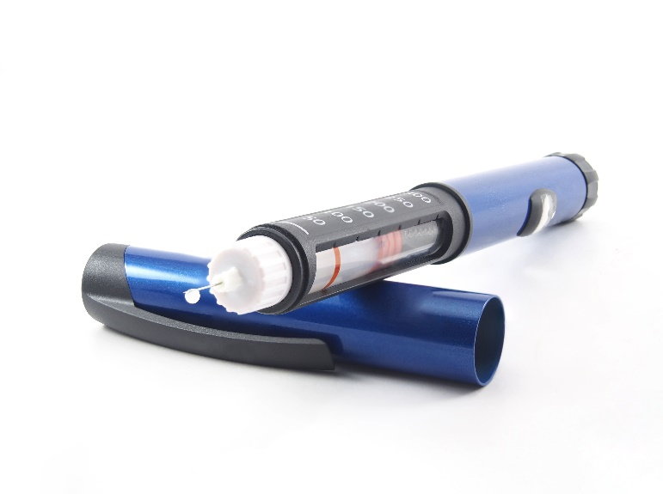
Indication of insulin
In all case of IDDM.
In some cases of NIDDM when
(1) not controlled by diet and exercise and drug or when these are not practicable.
(2)Primary or secondary failure of oral hypoglycaemic drugs, or when these drugs are not tolrated.
(3)Under wt patients.
(4)Temporarily to tide over infections,trauma surgery, pregnency.
(5) Any complication of diabetes eg ket-acidosis,gangrene of extremities.
Dose- Most of IDDM pts 0.4-0.8 U/kg/day.
In NIDDM pts 0.2-1.6 U/kg/day.

Slide 72
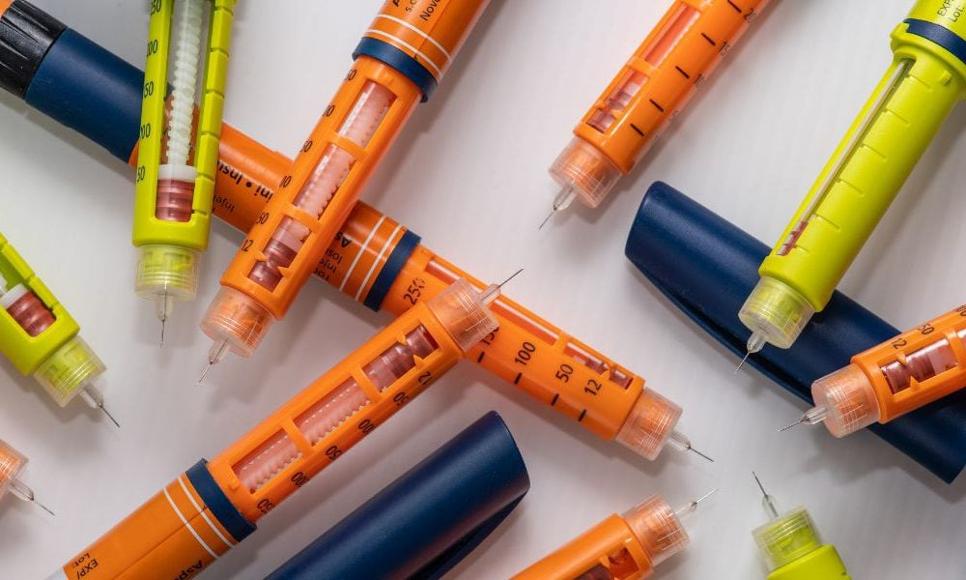
Adjusting Insulin dosage in a multiple-Injection schedule.
Initiation of Therapy.
O.6 to o.7 units insulin/ kg body wt.
25% NPH insulin at 9:00 pm,75% regular insulin in divided dosage.
Adjust NPH insulin every 48hrs based on fasting blood glucose.
<60mg/dl (-2 units).
˃90mg/dl (+2units).
Adjust regular insulin every 48hrs based on 1hrs PP glucose.
<60mg/dl (-2 units)
More than 140 mg/dl (+2 units)

Slide 73
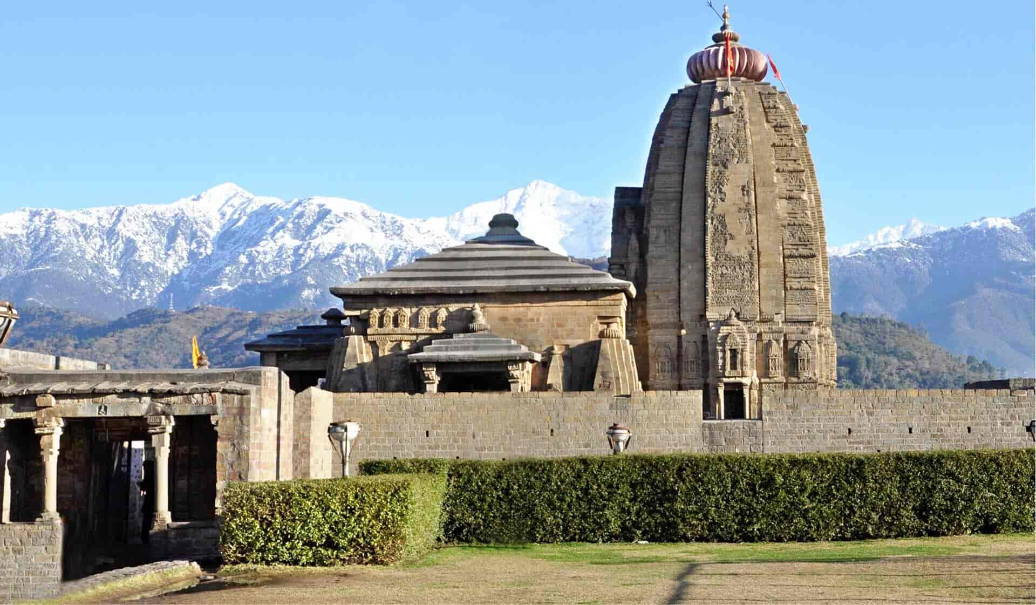
Thank you
"कर्पूरगौरं करुणावतारं संसारसारं भुजगेन्द्रहारम्। सदा वसन्तं हृदयारविन्दे भवं भवानीसहितं नमामि॥"

